Slide 1
Multi-layered Water-related Disaster Risk Reduction toward Early Warning for All
- Japan-
November 30, 2023
ESCAP/WMO TYPHOON COMMITTEE
18th Integrated Workshop / 4th TRCG FORUM
TECHNICAL PRESENTATIONS (PLENARY)
KIKUTA Tomoya
Director for International Coordination of River Engineering,
Water and Disaster Management Bureau
Ministry of Land, Infrastructure, Transport and Tourism (MLIT), Japan

Slide 2
TOC of Today’s Presentation
Multi-layered Water-related Disaster Risk Reduction toward Early Warning for All
- Japan-
EWS for flood risk reduction in Japan
[EWS in Japan]
Application to municipality governance
[EWS for Local Government]
Application to efficient dam control
[EWS for dam operation]
International contribution by Japan

Slide 3
TOC of Today’s Presentation
Multi-layered Water-related Disaster Risk Reduction toward Early Warning for All
- Japan-
EWS for flood risk reduction in Japan
[EWS in Japan]
Application to municipality governance
[EWS for Local Government]
Application to efficient dam control
[EWS for dam operation]
International contribution by Japan

Slide 4
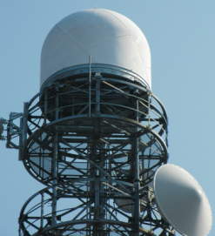
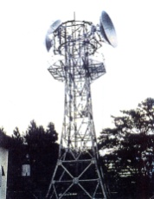
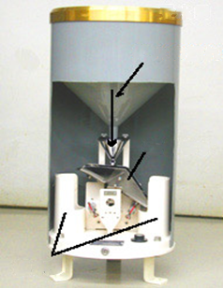

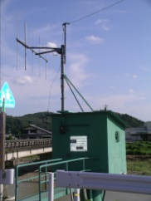
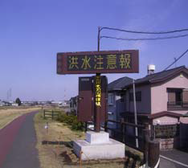
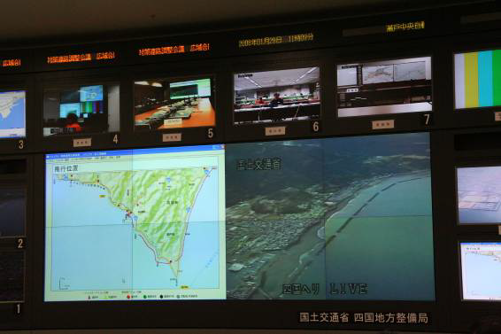
Hydrological observatory network in Japan
Relay station
Radar rainfall observatory
Ground rainfall observatory
catch of gauge
flow of rain water
tipping bucket
outlet
Water level / discharge observatory
Meteorological Observatory
Warning board
Disaster Management office
Regional Development Bureau
Notes:
Next, I would like to introduce the EARLY WARNING system in Japan.
In order to establish an early warning system, rainfall, water level, and flow rate observations are necessary.

Slide 5
Hydrological observatory network in Japan
Number of observation posts distributing data via automatic data transfer units (as of Mar. 2018)
Frequency of observations
Administrator | Rain gauge station | Water gauge station
River and disaster management bureau, MLIT | 3,490 | 1,934
Japan Meteorological Agency | 1,302 | －
Prefectures | 5,189 | 4,634
Total | 8,691 | 6,568
Type | Frequency
Ground rainfall observation | ▪ hourly ▪ 10 min (flood time, etc.)
Rader rainfall observation | ▪ C-band：5 min to 10 min ▪ X-band：1 min to 2 min
Water level observation | ▪ hourly ▪ 10 min (flood time, etc.)
Discharge observation | ▪ Low flow measurement: 36+ times / yr ▪ Flood flow measurement: 10 floods / yr
Notes:
Next, I would like to introduce the EARLY WARNING system in Japan.
In order to establish an early warning system, rainfall, water level, and flow rate observations are necessary.

Slide 6
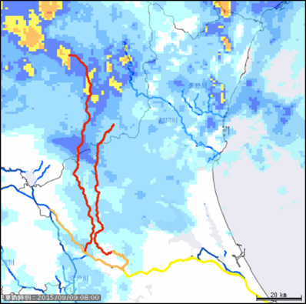
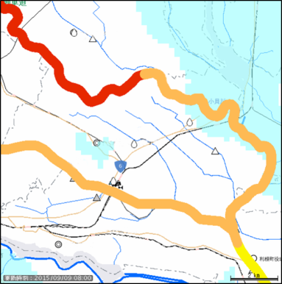
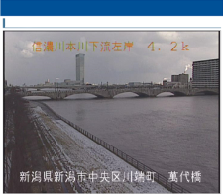
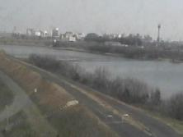

Flood risk information
Learn the current state of river water levels and rainfall.
Forecasts and warnings are issued in response to changes in water level, and the color of the river displayed will also change.
Click on the camera icon to check a live image showing the current condition of the river.
Learn the current rainfall status from radar.
Red: Flood Risk Information Issued
Tsukubamirai City Hall
Orange: Flood Warning Information Issued
Tochigi Pref.
Bandai Bridge
Live Camera
Ibaraki Pref.
Toride City Hall
Torede
Watarase River
Yellow: Flood Warning Issued
Camera Image
Tone River
Prefecture View
Municipality View
Notes:
Next, I would like to introduce the EARLY WARNING system in Japan.
In order to establish an early warning system, rainfall, water level, and flow rate observations are necessary.

Slide 7

Flood risk information
Understand the current risk of flooding based on the river water level.
When the river water level is rising, the mark (rising) will be displayed together with the water level information.
The higher the water level of nearby rivers, the greater the likelihood of flooding in your area.
For nearby rivers with a high risk of flooding, please ensure that you are safe and take appropriate disaster prevention action.
River Water Level Legend
Flood Danger Level | Level at which there is a danger of river flooding
Evacuation Decision Level | Level which provides the basis for issuing an evacuation order
Flood Warning Level | Level at which caution should be exercised for the river flooding
Flood Fighters Alert Level | Level at which flood fighters are placed on stand-by
Notes:
Next, I would like to introduce the EARLY WARNING system in Japan.
In order to establish an early warning system, rainfall, water level, and flow rate observations are necessary.

Slide 8
TOC of Today’s Presentation
Multi-layered Water-related Disaster Risk Reduction toward Early Warning for All
- Japan-
EWS for flood risk reduction in Japan
[EWS in Japan]
Application to municipality governance
[EWS for Local Government]
Application to efficient dam control
[EWS for dam operation]
International contribution by Japan

Slide 9
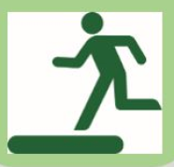
Integrated Water-Related Disaster Information System for Municipalities (IDR4M)
Integrated-System of Disaster Reduction for Municipalities (IDR4M)
Clear Evaluation Criteria (e.g. Water level, Rainfall amount
Evacuation Action
Huge amount of Disaster Information
Hazards, Vulnerabilities, etc
Mayor Decision
(e.g. Evacuation order)
Unclear Evaluation Criteria (e.g. degree of hazard concerning flooding and Mud-flow)
Using AI tech for Analysys
Problems at municipalities
Limited officials and lack of experience for disaster response
Huge amount of disaster related information to check in a short amount of time
IDR4M aims to provide disaster risk information to municipalities for science-based decision-making in disaster response operations, such as issuing evacuation order
Notes:
Next, I would like to introduce the EARLY WARNING system in Japan.
In order to establish an early warning system, rainfall, water level, and flow rate observations are necessary.

Slide 10
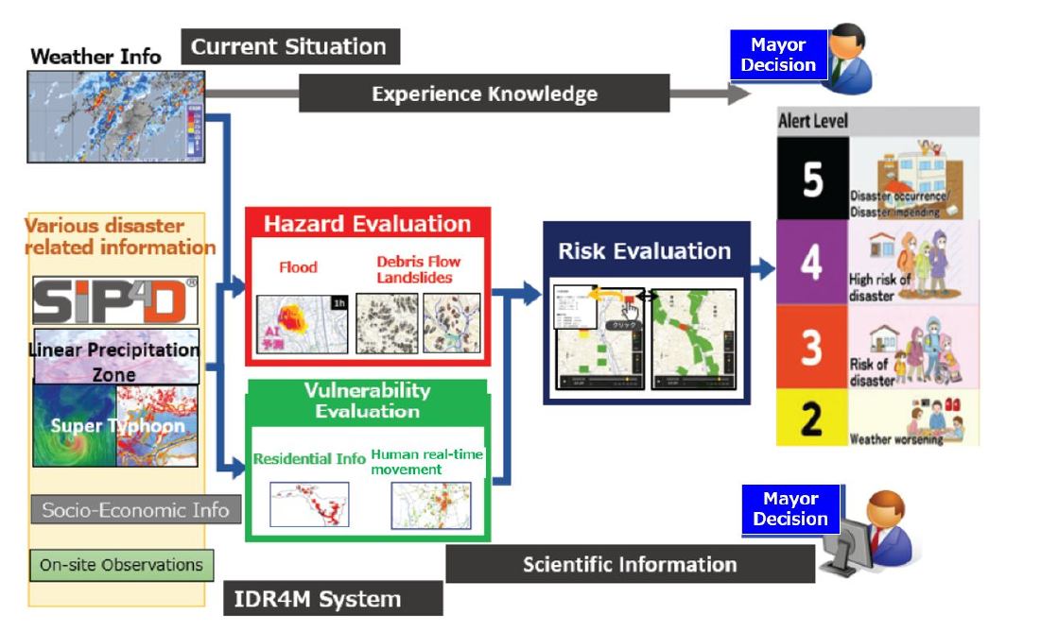
Integrated Water-Related Disaster Information System for Municipalities (IDR4M)
1) Integrate disaster information and deliver them to municipalities in a usable manner,
2) Develop an integrated hazards/vulnerabilities risk information system, and
3) Provide real-time/pinpoint risk information to residents.
Notes:
Next, I would like to introduce the EARLY WARNING system in Japan.
In order to establish an early warning system, rainfall, water level, and flow rate observations are necessary.

Slide 11
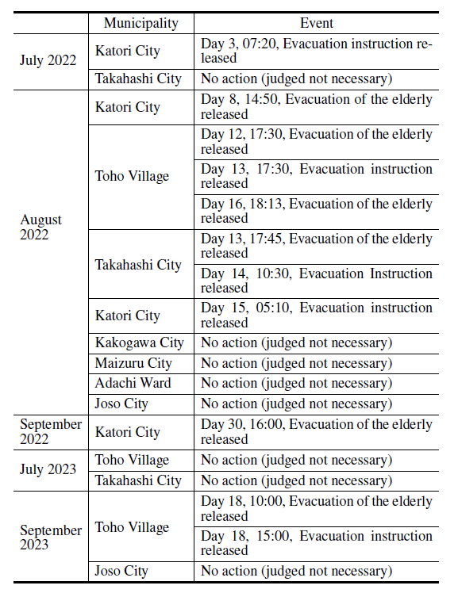
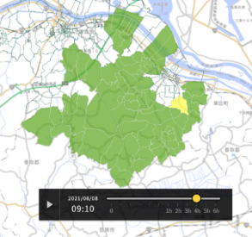
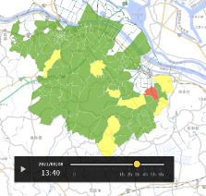
Integrated Water-Related Disaster Information System for Municipalities (IDR4M)
【Usage example: IDR4M Disaster risk of Katori city
affected by Typhoon No.8, on August 8, 2021】
July 2021
9:10 Disaster risk forecast after 4 hours; 13:10
13:36 issued
“Heavy rain warning”
August
2021
13:40 Disaster risk forecast after 3 hours; 16:40
Sept. 2021
14:50 issued “Evacuation of the elderly, etc”
July 2022
Legend: Disaster risk
Evacuation（Evacuation Instruction）
Preparation（Evacuation of the Elderly, Etc）
Advisory
Sept. 2022
Notes:
Next, I would like to introduce the EARLY WARNING system in Japan.
In order to establish an early warning system, rainfall, water level, and flow rate observations are necessary.

Slide 12
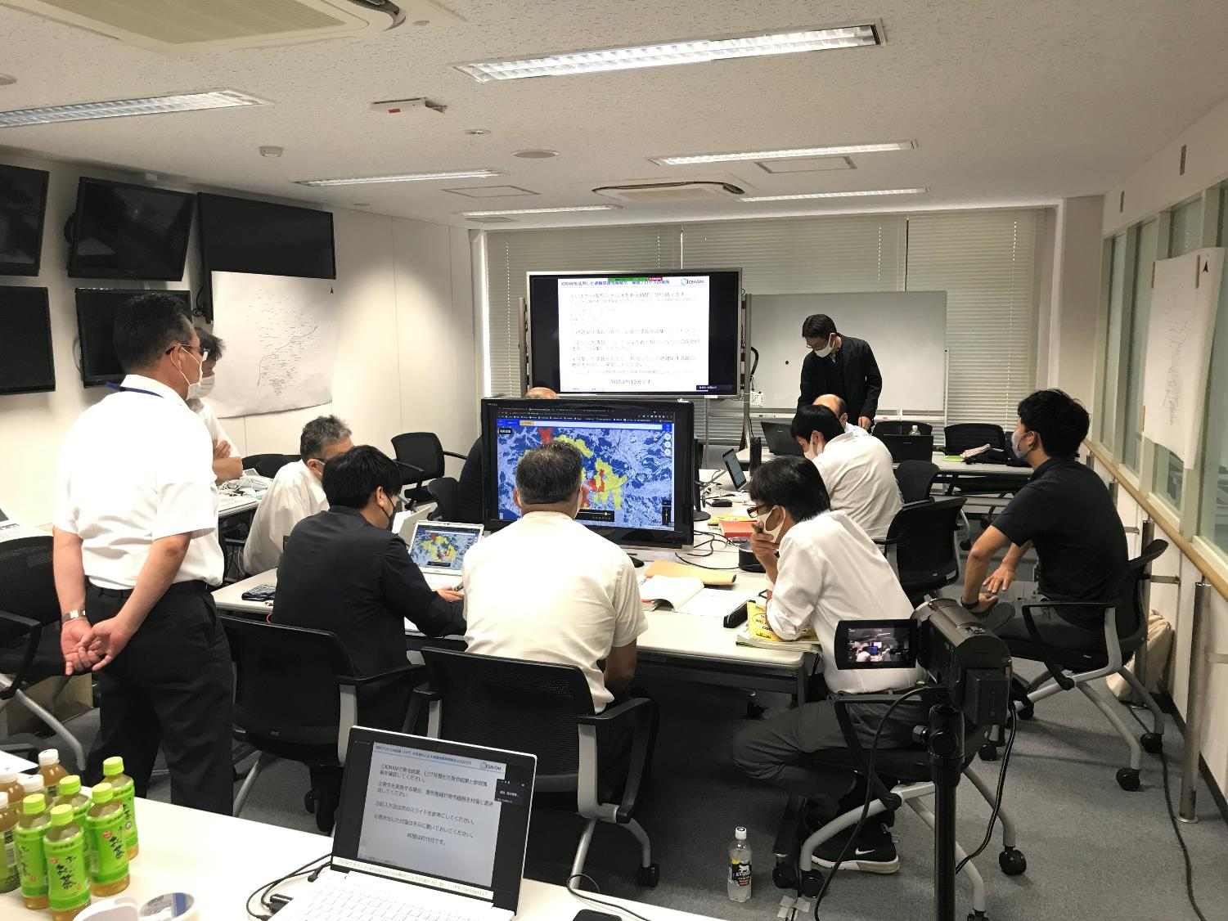
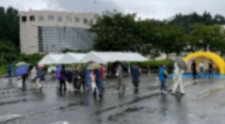

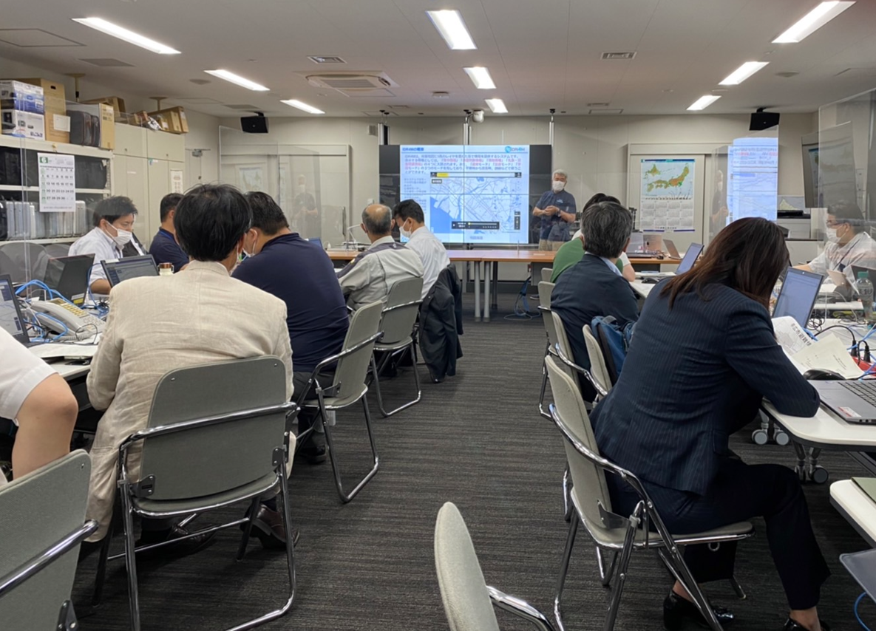
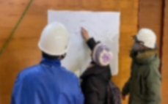
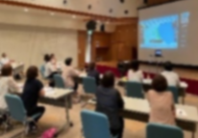
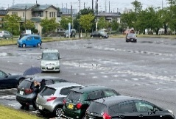
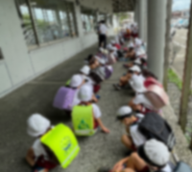
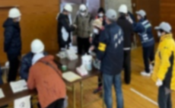
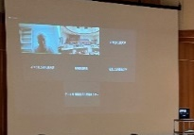
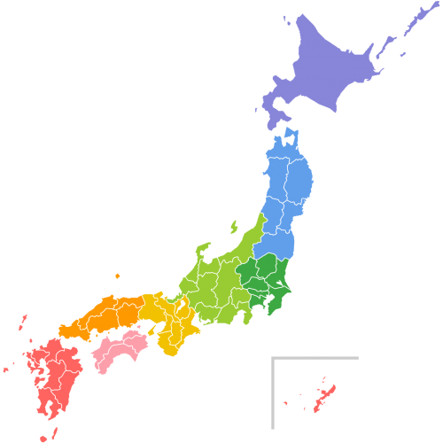
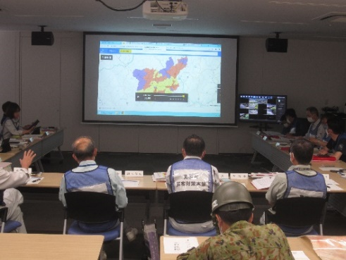
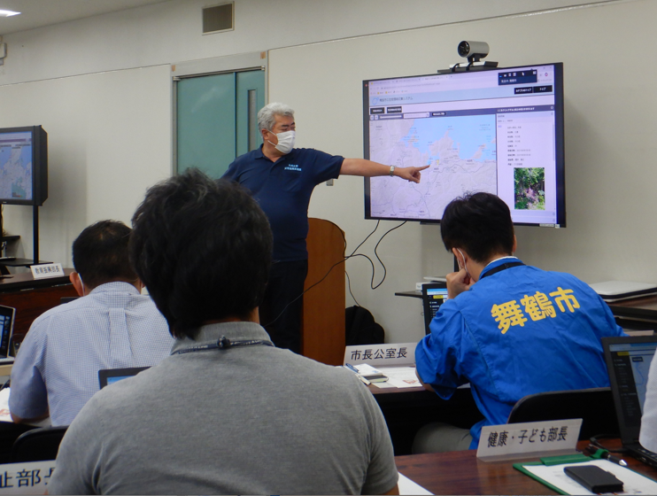
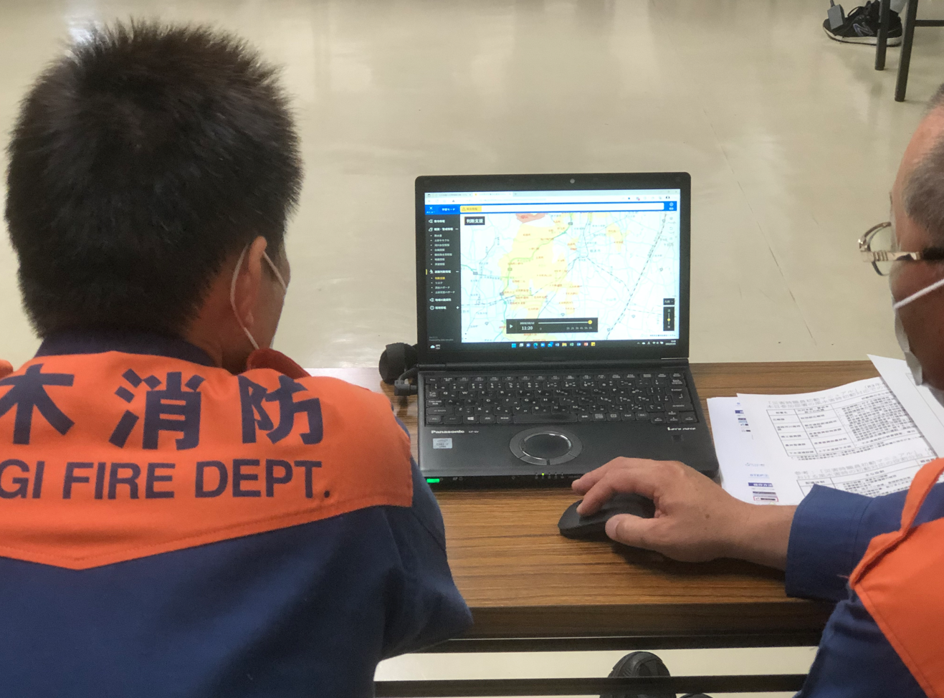
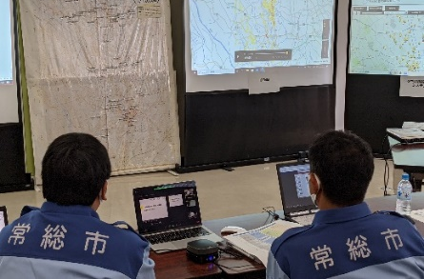
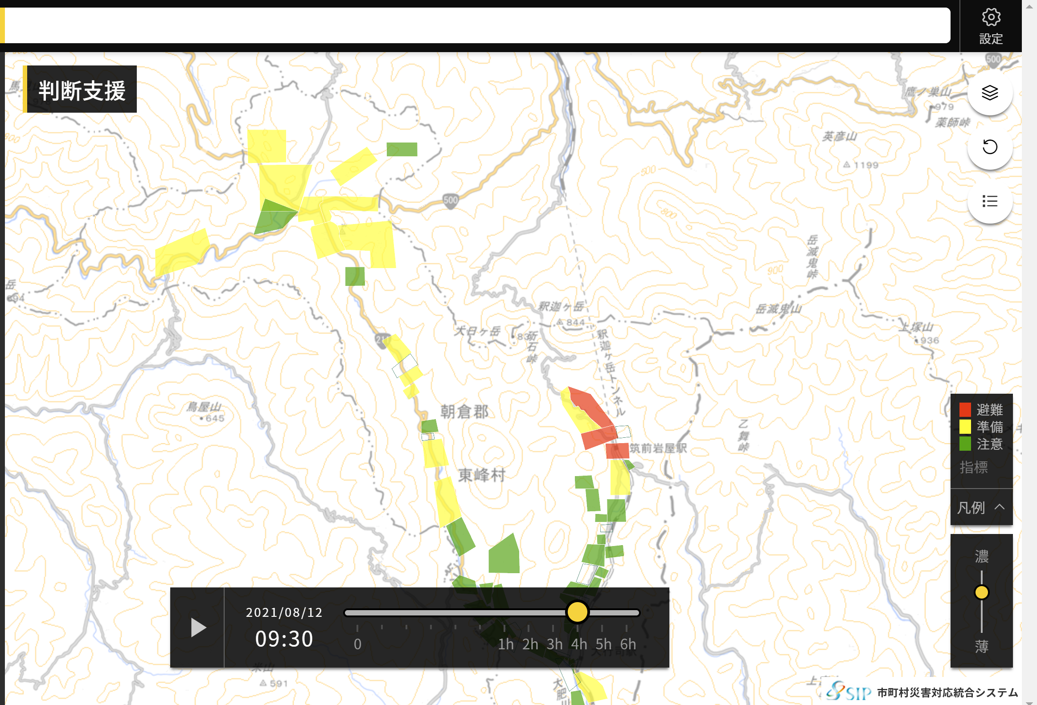
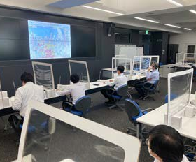
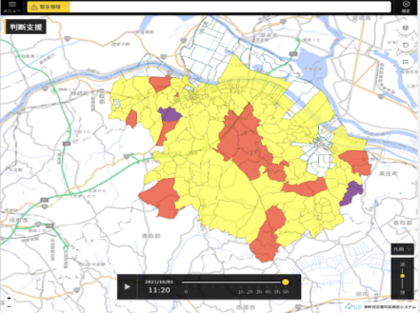
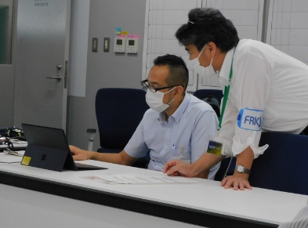
Integrated Water-Related Disaster Information System for Municipalities (IDR4M)
Selected 18 municipalities from whole Japan in terms of different topography and characteristics.
Conducted demonstration experiment in the model municipalities.
Kakogawa City, Hyogo
Himi City, Toyama
Ngaoka Citym Niigata
Obihiro City, Shintoku Town, Sikaoi Town and Memuro Town, Hokkaido
Takahashi City, Okayama
Maizuru City, Kyoto
Tochigi City, Tochigi
Joso Citym Ibaraki
Toho Village, Fukuoka
Takamatsu City, Kagawa
Fujikawaguchiko Town, Yamanashi
Adachi Ward, Tokyo
Katori Citym Chiba
Notes:
Next, I would like to introduce the EARLY WARNING system in Japan.
In order to establish an early warning system, rainfall, water level, and flow rate observations are necessary.

Slide 13
TOC of Today’s Presentation
Multi-layered Water-related Disaster Risk Reduction toward Early Warning for All
- Japan-
EWS for flood risk reduction in Japan
[EWS in Japan]
Application to municipality governance
[EWS for Local Government]
Application to efficient dam control
[EWS for dam operation]
International contribution by Japan

Slide 14


Long-term rainfall prediction and decision support system for the Integrated dam operation
Handling uncertainty contained in the predictions has been issues.
Pre-release
Insufficient water recovery
It is difficult to know suitable amount of preliminary release volume because of rainfall prediction uncertainty.
Inflow less than predicted
Overestimated prediction
Before a flood event
After the flood event
Tradeoff on dam operation
No pre-release
Risk of overflow
Inflow more than predicted
Normal period
Flood risk reduction
Secure stable water supply,
Renewable energy
Underestimated prediction
SIP Model
Nohara 2020
Before a flood event
After the flood event
Cross-ministerial Strategic Innovation Promotion Program
Notes:
Next, I would like to introduce the EARLY WARNING system in Japan.
In order to establish an early warning system, rainfall, water level, and flow rate observations are necessary.

Slide 15

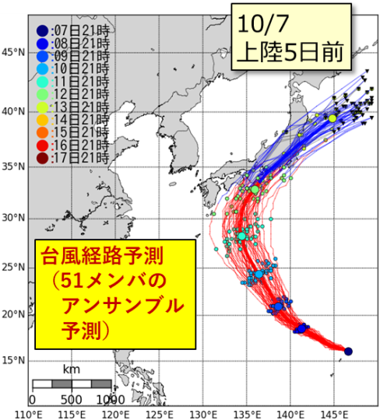
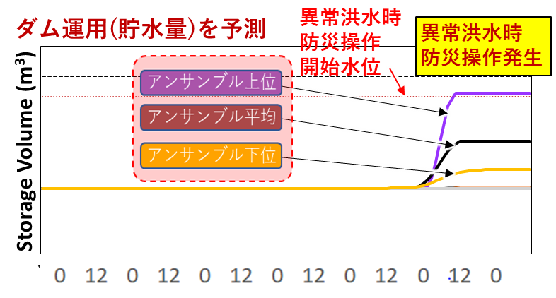
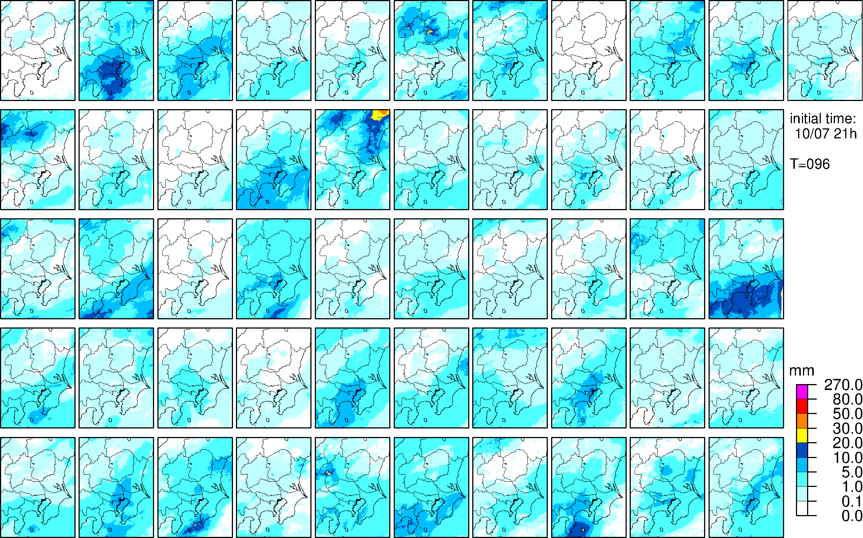
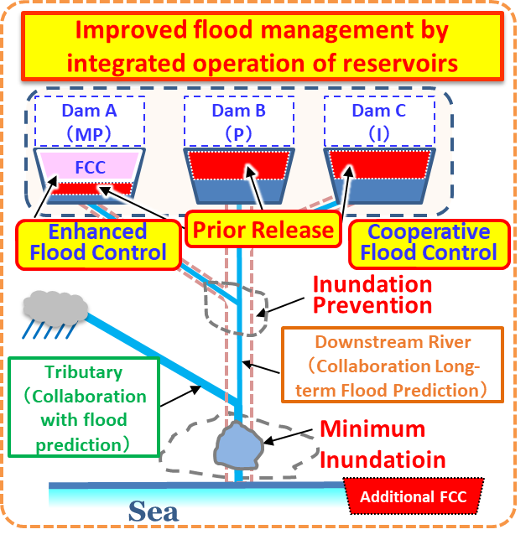
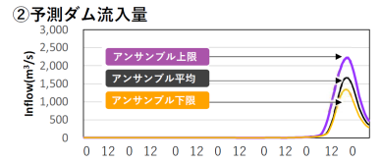
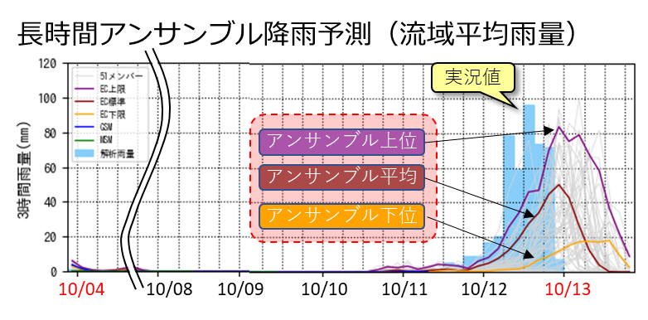
Long-term rainfall prediction and decision support system for the Integrated dam operation
⑥Optimization of dam flood mitigation operation
②Ensemble rainfall prediction
①Ensemble prediction of typhoon track
⑤Ensemble accumulated storage volume (3 representatives)
Triggered by Ensemble High but storage volume is defined by Ensemble Low for secure storage recovery.
ECMWF, 51 Ensemble,
15 days advance, Downscaling 1km, 1hr
Prediction of necessary storage volume
DRO/EF Occur Level
Ensemble High
Ensemble Mean
Ensemble Low
⑦Integrated Operation of Reservoir Systems
④Ensemble inflow discharge (3 representatives)
③Ensemble rainfall prediction (51 ensemble)
Ensemble High
Ensemble Mean
Ensemble Low
Ensemble High
Ensemble Mean
Ensemble Low
Rainfall-Runoff Modelling
ECMWF（15Days)
GSM（84hrs）
EWS for dam operation
Notes:
Next, I would like to introduce the EARLY WARNING system in Japan.
In order to establish an early warning system, rainfall, water level, and flow rate observations are necessary.

Slide 16
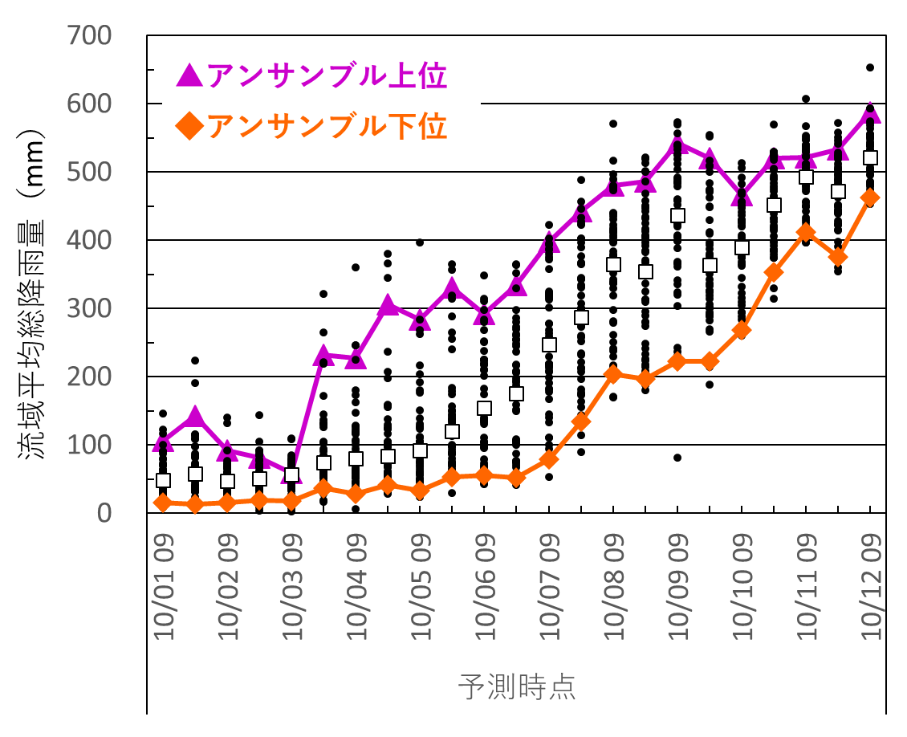
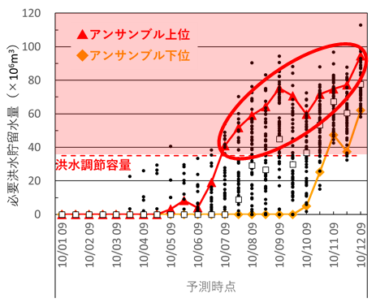
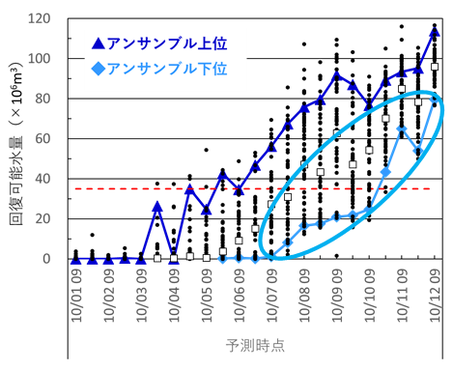
Long-term rainfall prediction and decision support system for the Integrated dam operation
Rainfall Prediction in Reservoir Catchment Area
Dam Inflow Prediction
①Necessary storage volume for flood control
②Possible recovery storage volume
Ensemble High
Ensemble Low
Ensemble High
Ensemble Low
Ensemble High
Ensemble Low
Inflow excess flood control volume
Accumulated rainfall (mm)
Necessary storage volume(×10⁶m³)
Possible recovery volume(×10⁶m³)
Flood control volume
Ensemble High: Mean value of No.1-5
Ensemble Low：Mean value of No.47-51
Detection of occurrence of DRO/EF （5 days before Typhoon landing）
Target drawdown volume is increasing gradually keeping secure water recovery
(Kido et. al. 2020)
SIP Ensemble pre-release operation (SIP-EPRO)
Balancing both flood and water security risks.
Using Long-term Ensemble rainfall prediction, optimum drawdown storage volume is obtained by adaptive pre-release under prediction uncertainty.
Notes:
Next, I would like to introduce the EARLY WARNING system in Japan.
In order to establish an early warning system, rainfall, water level, and flow rate observations are necessary.

Slide 17
TOC of Today’s Presentation
Multi-layered Water-related Disaster Risk Reduction toward Early Warning for All
- Japan-
EWS for flood risk reduction in Japan
[EWS in Japan]
Application to municipality governance
[EWS for Local Government]
Application to efficient dam control
[EWS for dam operation]
International contribution by Japan

Slide 18
Kumamoto Initiative for Water -Overview-
1. Promoting both climate change adaptation and mitigation measures
Use of observation/forecast data
Climate change adaptation measures
River basin sustainability and resilience against water-related disaster risks
Flooding of rivers
Inland flooding
Flooding in rural areas
Satellite observation
Development of “Quality Infrastructure” by the use of hybrid technology to implement both adaptation and mitigation measure
Forecast technology
Data integration & analysis
Effective use of existing dams
Evaluation of water-related disaster risks
Operational improvement (operation rules)
Preliminary release operation
Higher hydroelectric power generation efficiency
Enhancement of discharge facilities
Raising of the dam height
Risk map/Flood analysis
Renewal (redevelopment) of dams
Support corporate investment and countries in which the measures are implemented
Creation of clean energy
Promotion of energy conservation
Reduction of greenhouse gas emissions
Sewerage systems
Reduction of inundation in urban areas / Use of sewage sludge for biomass power generation
Planning and operation of facilities
Irrigation and drainage facilities
Reduction of flooding in rural areas by the use of the rainwater storage function of paddy fields
Reduction of greenhouse gas emissions through small hydroelectric power generation
Climate change mitigation measures
Enhancement of governance and systems
- Cooperation with the related organizations of each country and human resource development
- Cooperation with assistance organizations and international organizations
Solution of social issues
Sustainable economic growth
2. Promotion of measures to improve people’s basic living environment
Local governments’ know-how and
technologies
Use of IoT technologies
Water supply
Ensuring access to safe water
Maintenance of sanitary environments
Expansion and updating of water supply facilities
Sanitation facilities
Capacity building for the operation and management of the facilities
Providing financial assistance worth approximately 500 billion yen over the next five years
Notes:
Next, I would like to introduce the EARLY WARNING system in Japan.
In order to establish an early warning system, rainfall, water level, and flow rate observations are necessary.

Slide 19
EWS-related component of the Initiative
MLIT of Japan proposes the “Flood Risk Mapping with Ground /Satellite Observation Data” as the new Annual Operation Plan No.6 [New AOP6] (2024-2027) under the Working Group of Hydrology [WGH] in ESCAP/WMO Typhoon Committee [TC].
Use of observation/forecast data
Satellite observation
Forecast technology
Data integration & analysis
Evaluation of water-related disaster risks
Risk map/Flood analysis
Support corporate investment and countries in which the measures are implemented
Notes:
Next, I would like to introduce the EARLY WARNING system in Japan.
In order to establish an early warning system, rainfall, water level, and flow rate observations are necessary.

Slide 20
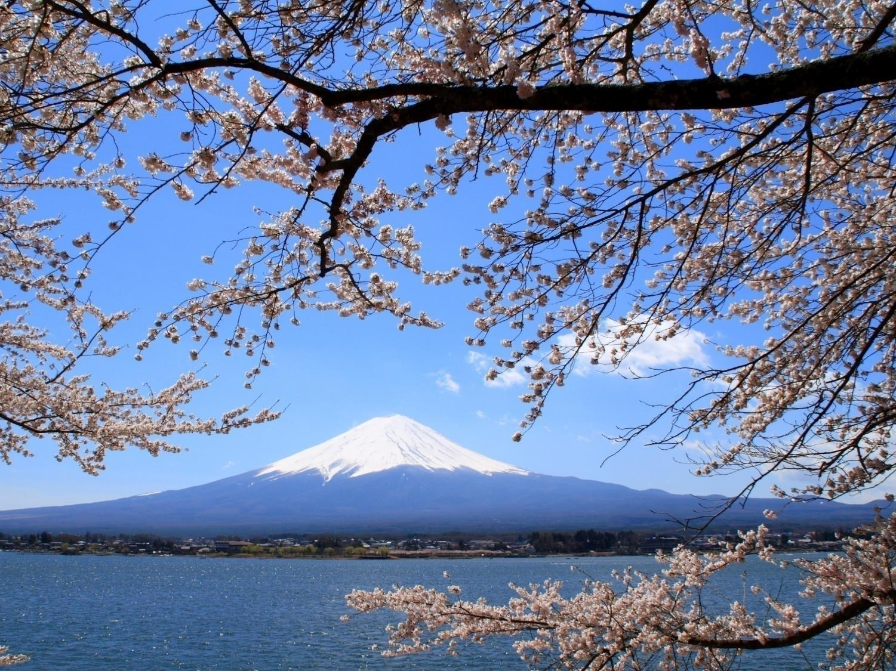
ありがとうございました。
Thank you for your kind attention.

